Slide 1
L8. Machine Learning
(Classification)

Slide 2
Contents
Non-Bayesian approaches
Discriminative model
Logistic regression
Neural Network
Generative model
Gaussian Discriminative Analysis
Naïve Bayes classification
Full Bayesian approach for classification
Bayesian Logistic regression
Bayesian Neural Network

Slide 3
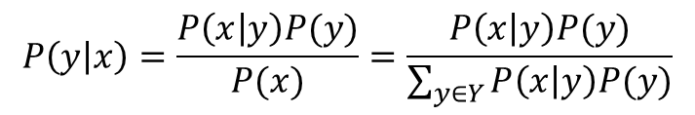
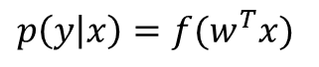
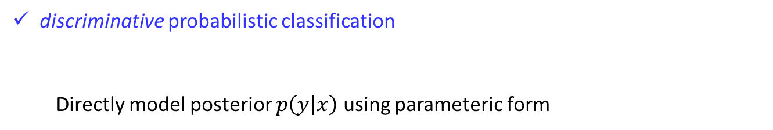
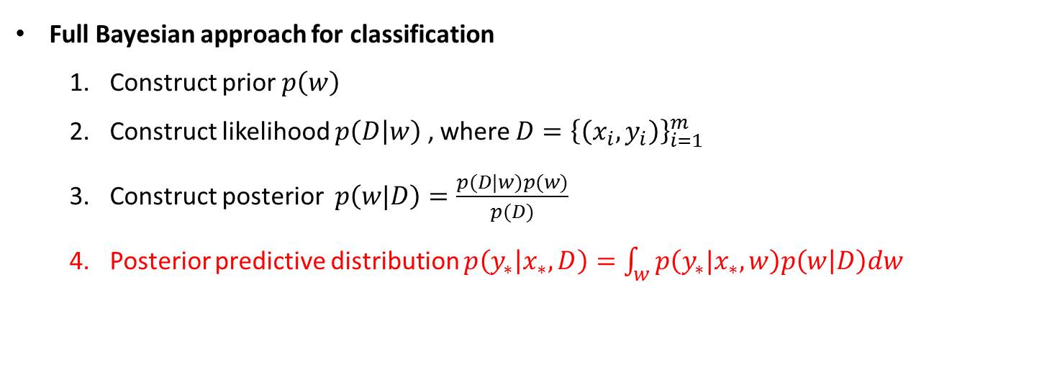
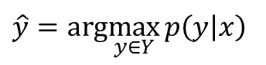
Non-Bayesian vs Bayesian
Non-Bayesian approaches
discriminative probabilistic classification
Directly model posterior $p\left(y | x\right)$ using parameteric form
$$p\left(y | x\right)=f(w^{T}x)$$
$$\hat{y}=arg\max_{y∈Y}{p\left(y | x\right) }$$
Generative probabilistic classification
$$P\left(y | x\right)=\frac{P\left(x | y\right)P(y)}{P(x)}=\frac{P\left(x | y\right)P(y)}{\sum_{y∈Y}^{ }{P\left(x | y\right)P(y)}}$$
Model $P\left(x | y\right)$ and $P\left(y\right)$ and combined them in Bayes’ rule
Full Bayesian approach for classification
Construct prior $p\left(w\right)$
Construct likelihood $p\left(D | w\right)$ , where $D={\left\{\left(x_{i}, y_{i}\right)\right\}}_{i=1}^{m}$
Construct posterior $p\left(w|D\right)=\frac{p(D|w)p(w)}{p(D)}$
Posterior predictive distribution $p\left(y_{∗} | x_{∗},D\right)=\int_{w}^{ }{p\left(y_{∗}|x_{∗},w\right)p\left(w | D\right)dw}$

Slide 4
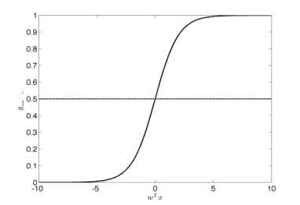

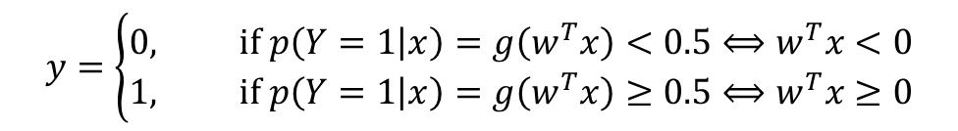
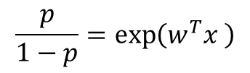

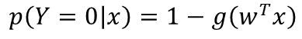
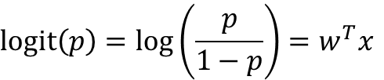
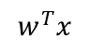

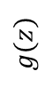
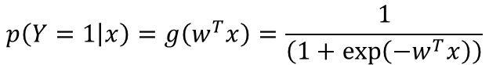
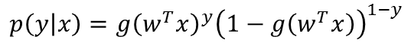
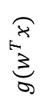
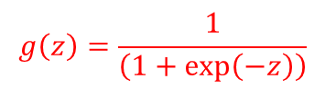
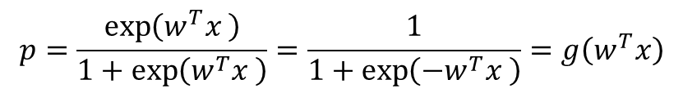
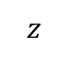
Logistic regression
Logistic regression is discriminative probabilistic linear classification :$p\left(y | x\right)=g(w^{T}x)$
$$logit\left(p\right)=log\left(\frac{p}{1−p}\right)=w^{T}x$$
$$g\left(z\right)=\frac{1}{\left(1+\exp\left(−z\right)\right)}$$
$$\frac{p}{1−p}=\exp\left(w^{T}x \right)$$
$$g(z)$$
$$p=\frac{\exp\left(w^{T}x \right)}{1+\exp\left(w^{T}x \right)}=\frac{1}{1+\exp\left(−w^{T}x \right)}=g\left(w^{T}x\right)$$
$$z$$
For a two-classes classification function $f:X→Y or p(Y|X)$ , the posterior probability of the class $Y$ can be written as (w is assumed to be fixed)
$$p\left(Y=1 | x\right)=g\left(w^{T}x\right)=\frac{1}{\left(1+\exp\left(−w^{T}x\right)\right)}$$
$$1$$
$$p\left(Y=0 | x\right)=1−g\left(w^{T}x\right)$$
$$p\left(y | x\right)=g{\left(w^{T}x\right)}^{y}{\left(1−g\left(w^{T}x\right)\right)}^{1−y}$$
$$g(w^{T}x)$$
Classification rule:
$$0$$
$$y=\left\{\begin{aligned}0, if p\left(Y=1 | x\right)=g\left(w^{T}x\right)<0.5⟺w^{T}x<0 \\ 1, if p\left(Y=1 | x\right)=g\left(w^{T}x\right)≥0.5⟺w^{T}x≥0\end{aligned}\right.$$
$$w^{T}x$$

Slide 5
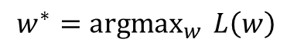
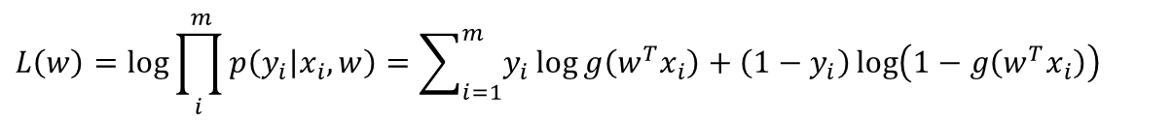
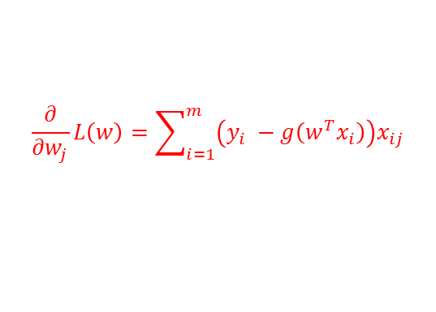
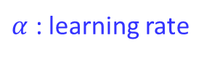
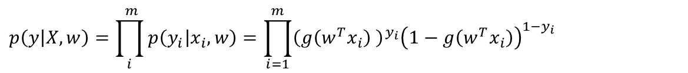
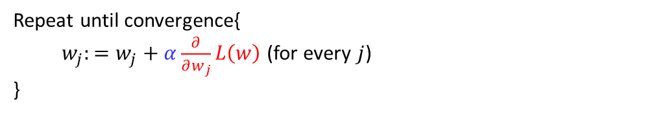
Logistic regression – how to find $w$
Likelihood for a single point can be specified as
$$p(y_{i}|x_{i}, w)={\left(g\left(w^{T}x_{i}\right) \right)}^{y_{i}}{\left(1−g\left(w^{T}x_{i}\right)\right)}^{1−y_{i}}$$
Likelihood for whole training data $(X$, $y)$ can be specified as
$$p\left(y | X, w\right)=\prod_{i}^{ m}{p\left(y_{i} | x_{i},w\right)=\prod_{i=1}^{m}{{\left(g\left(w^{T}x_{i}\right) \right)}^{y_{i}}{\left(1−g\left(w^{T}x_{i}\right)\right)}^{1−y_{i}}}}$$
Note that this is similar to the likelihood of Binomial dist.
Log-likelihood
$$L\left(w\right)=log\prod_{i}^{ m}{p\left(y_{i} | x_{i},w\right)=\sum_{i=1}^{m}{y_{i}\log{g\left(w^{T}x_{i}\right)}}+\left(1−y_{i}\right)\log\left(1−g\left(w^{T}x_{i}\right)\right)}$$
Learning
Maximizing the log-likelihood function
$${w^{∗}={argmax}_{w}{L\left(w\right) }}_{ }$$
Gradient ascent algorithm
Repeat until convergence{
$w_{j}:=w_{j}+α\frac{∂}{∂w_{j}}L\left(w\right)$ (for every $j$)
}
$α$ : learning rate
$$\frac{∂}{∂w_{j}}L\left(w\right)=\sum_{i=1}^{m}{\left(y_{i} −g\left(w^{T}x_{i}\right)\right)x_{ij}}$$

Slide 6
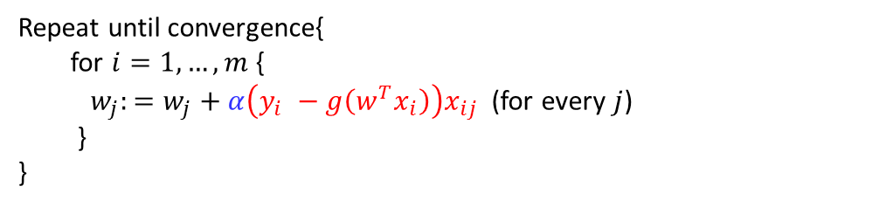
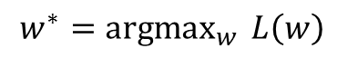
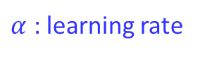
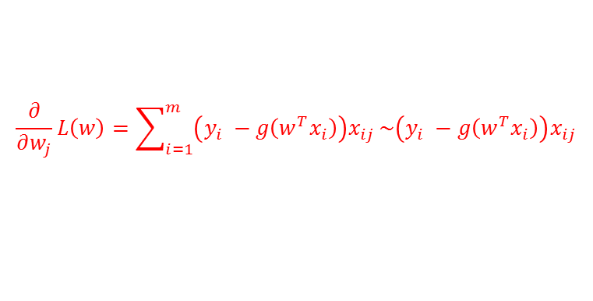
Logistic regression
Likelihood for a single point $(x_{i}$, $y_{i})$ can be specified as
$$p(y_{i}|x_{i}, w)={\left(g\left(w^{T}x_{i}\right) \right)}^{y_{i}}{\left(1−g\left(w^{T}x_{i}\right)\right)}^{1−y_{i}}$$
Likelihood for whole training data $(X$, $y)$ can be specified as
$$p\left(y | X, w\right)=\prod_{i}^{ m}{p\left(y_{i} | x_{i},w\right)=\prod_{i=1}^{m}{{\left(g\left(w^{T}x_{i}\right) \right)}^{y_{i}}{\left(1−g\left(w^{T}x_{i}\right)\right)}^{1−y_{i}}}}$$
Note that this is similar to the likelihood of Binomial dist.
Log-likelihood
$$L\left(w\right)=log\prod_{i}^{ m}{p\left(y_{i} | x_{i},w\right)=\sum_{i=1}^{m}{y_{i}\log{g\left(w^{T}x_{i}\right)}}+\left(1−y_{i}\right)\log\left(1−g\left(w^{T}x_{i}\right)\right)}$$
Learning
Maximizing the log-likelihood function
$${w^{∗}={argmax}_{w}{L\left(w\right) }}_{ }$$
Stochastic gradient ascent algorithm
Repeat until convergence{
for $i=1,…, m${
$w_{j}:=w_{j}+α\left(y_{i} −g\left(w^{T}x_{i}\right)\right)x_{ij}$ (for every $j$)
}
}
$α$ : learning rate
$$\frac{∂}{∂w_{j}}L\left(w\right)=\sum_{i=1}^{m}{\left(y_{i} −g\left(w^{T}x_{i}\right)\right)x_{ij}}\sim \left(y_{i} −g\left(w^{T}x_{i}\right)\right)x_{ij}$$

Slide 7
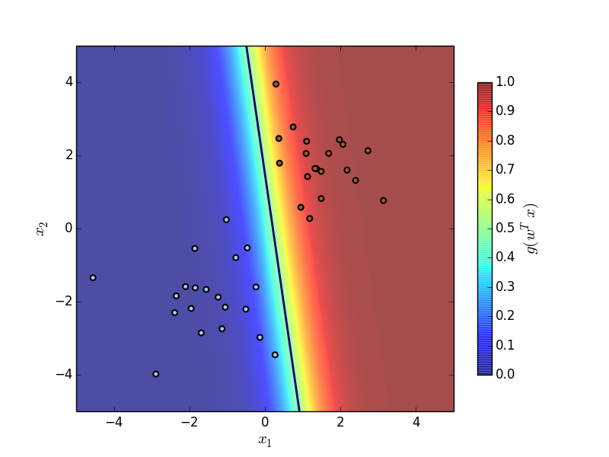
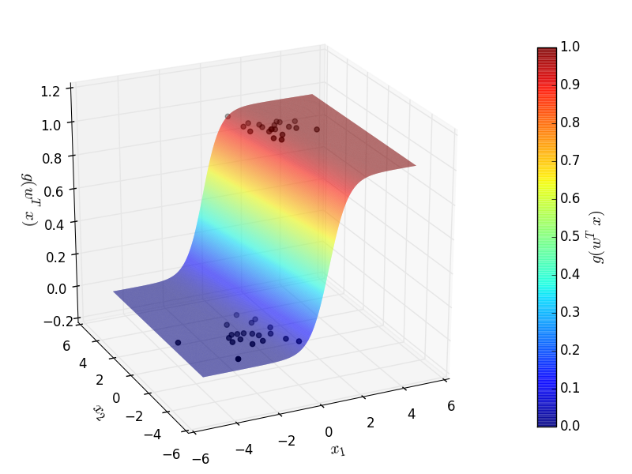
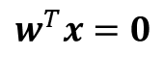
Logistic regression
Classification line
$$w^{T}x=0$$

Slide 8
Logistic regression
Jupyter Demo Simulation

Slide 9
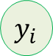
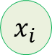
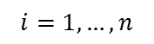

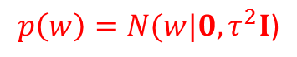
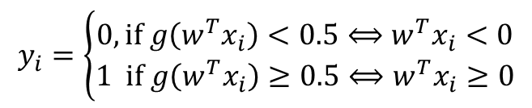



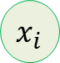
Bayesian Logistic Regression
Logistic Regression
Bayesian Logistic Regression
Fixed hyper-parameter
$$τ$$
Fixed parameter
(to be determined)
$$w$$
$$w$$
$$p\left(w\right)=N(w|0,τ^{2}I\text{)}$$
$$x_{i}$$
$$x_{i}$$
$$y_{i}$$
$$y_{i}$$
$$i=1,…,n$$
$$i=1,…,n$$
$$y_{i}=\left\{\begin{aligned}0, if g\left(w^{T}x_{i}\right)<0.5⟺w^{T}x_{i}<0 \\ 1 if g\left(w^{T}x_{i}\right)≥0.5⟺w^{T}x_{i}≥0\end{aligned}\right.$$

Slide 10
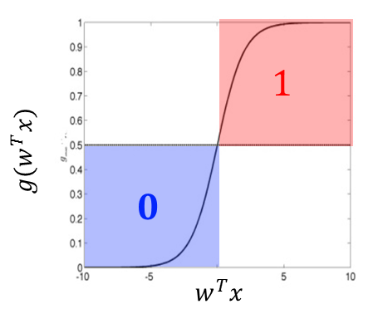
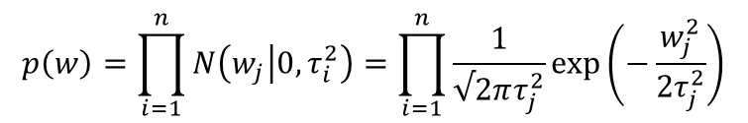
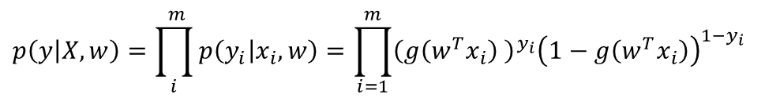

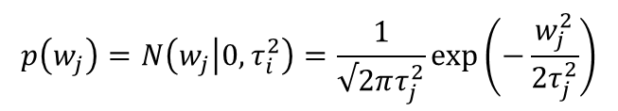
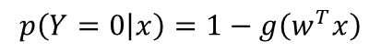

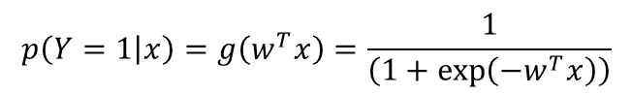
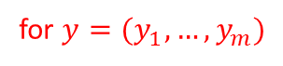
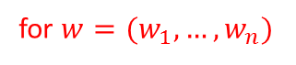
Bayesian Logistic Regression with Gaussian Prior (Ridge Logistic Regression)
We have a logistic regression model :
$$p\left(Y=1 | x\right)=g\left(w^{T}x\right)=\frac{1}{\left(1+\exp\left(−w^{T}x\right)\right)}$$
$$p\left(Y=0 | x\right)=1−g\left(w^{T}x\right)$$
Likelihood can be specified as
$$p(y_{i}|x_{i}, w)={\left(g\left(w^{T}x_{i}\right) \right)}^{y_{i}}{\left(1−g\left(w^{T}x_{i}\right)\right)}^{1−y_{i}}$$
for $y=(y_{1},…,y_{m})$
$$p\left(y | X, w\right)=\prod_{i}^{ m}{p\left(y_{i} | x_{i},w\right)=\prod_{i=1}^{m}{{\left(g\left(w^{T}x_{i}\right) \right)}^{y_{i}}{\left(1−g\left(w^{T}x_{i}\right)\right)}^{1−y_{i}}}}$$
Prior on parameter $w$ can be specified as
$$p\left(w_{j}\right)=N\left(w_{j} | 0,τ_{i}^{2}\right)=\frac{1}{√2πτ_{j}^{2}}\exp\left(−\frac{w_{j}^{2}}{2τ_{j}^{2}}\right)$$
for $w=(w_{1},…,w_{n})$
$$p\left(w\right)=\prod_{i=1}^{n}{N\left(w_{j} | 0,τ_{i}^{2}\right)=\prod_{i=1}^{n}{\frac{1}{√2πτ_{j}^{2}}\exp\left(−\frac{w_{j}^{2}}{2τ_{j}^{2}}\right)}}$$
With the fixed variance $τ_{j}^{2}$ quantifying our belief that $w_{j}$ is close to 0.
For simple case, $τ_{j}^{2}=τ^{2}$ for $j=1,…,n$

Slide 11
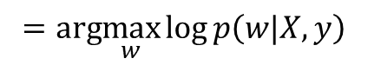
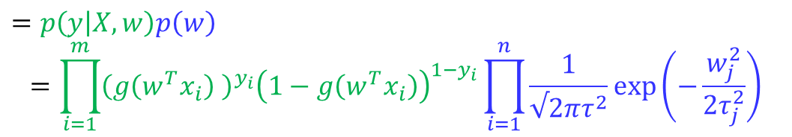
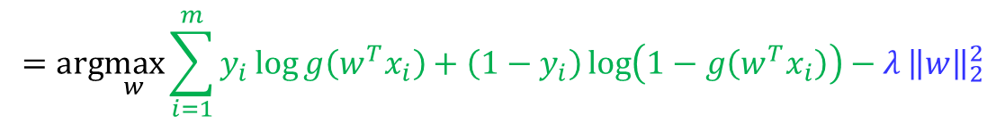
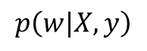
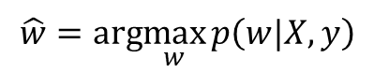
Bayesian Logistic Regression with Gaussian Prior (Ridge Logistic Regression)
We need to compute the posterior:
$$p\left(w|X,y\right)$$
$$=p\left(y | X, w\right)p\left(w\right)$$
$$=\prod_{i=1}^{m}{{\left(g\left(w^{T}x_{i}\right) \right)}^{y_{i}}{\left(1−g\left(w^{T}x_{i}\right)\right)}^{1−y_{i}}}\prod_{i=1}^{n}{\frac{1}{√2πτ^{2}}\exp\left(−\frac{w_{j}^{2}}{2τ_{j}^{2}}\right)}$$
$$\log{p\left(w|X,y\right)=}\sum_{i=1}^{m}{y_{i}\log{g\left(w^{T}x_{i}\right)}+\left(1−y_{i}\right)\log\left(1−g\left(w^{T}x_{i}\right)\right)}+nlog\left(\frac{1}{√2πτ^{2}}\right) −\sum_{j=1}^{n}{\frac{w_{j}^{2}}{2τ_{j}^{2}}}$$
The MAP estimate of $w$ is then simply
$$\hat{w}=arg\max_{w}{p\left(w|X,y\right){ }}$$
$$=arg\max_{w}{\log{p\left(w|X,y\right)}{ }}$$
$$=arg\max_{w}{\sum_{i=1}^{m}{y_{i}\log{g\left(w^{T}x_{i}\right)}+\left(1−y_{i}\right)\log\left(1−g\left(w^{T}x_{i}\right)\right)}−λ}{\left\|w\right\|}_{2}^{2}$$
Data fitness
complexity

Slide 12




Bayesian Logistic Regression with Laplace Prior (Lasso Logistic Regression)
We have a logistic regression model :
$$p\left(Y=1 | x\right)=g\left(w^{T}x\right)=\frac{1}{\left(1+\exp\left(−w^{T}x\right)\right)}$$
$$p\left(Y=0 | x\right)=1−g\left(w^{T}x\right)$$
Likelihood can be specified as
$$p(y_{i}|x_{i}, w)={\left(g\left(w^{T}x_{i}\right) \right)}^{y_{i}}{\left(1−g\left(w^{T}x_{i}\right)\right)}^{1−y_{i}}$$
for $y=(y_{1},…,y_{m})$
$$p\left(y | X, w\right)=\prod_{i}^{ m}{p\left(y_{i} | x_{i},w\right)=\prod_{i=1}^{m}{{\left(g\left(w^{T}x_{i}\right) \right)}^{y_{i}}{\left(1−g\left(w^{T}x_{i}\right)\right)}^{1−y_{i}}}}$$
Prior on parameter $w$ can be specified using Laplacian as
$$p\left(w_{j}\right)=\frac{λ_{j}}{2}\exp\left(−λ_{j}|w_{j}|\right)$$
for $w=(w_{1},…,w_{n})$
$$p\left(w\right)=\prod_{j=1}^{n}{\frac{λ_{j}}{2}\exp\left(−λ_{j}|w_{j}|\right)}$$
With the fixed variance $λ_{j}$ quantifying our belief that $w_{j}$ is close to 0.
For simple case, $λ_{j}=λ$ for $j=1,…,n$

Slide 13




Bayesian Logistic Regression with Laplace Prior (Lasso Logistic Regression)
We need to compute the posterior:
$$p\left(w|X,y\right)$$
$$=p\left(y | X, w\right)p\left(w\right)$$
$$=\prod_{i=1}^{m}{{\left(g\left(w^{T}x_{i}\right) \right)}^{y_{i}}{\left(1−g\left(w^{T}x_{i}\right)\right)}^{1−y_{i}}}\prod_{j=1}^{n}{\frac{λ_{j}}{2}\exp\left(−λ_{j}|w_{j}|\right)}$$
$$\log{p\left(w|X,y\right)=}\sum_{i=1}^{m}{y_{i}\log{g\left(w^{T}x_{i}\right)}+\left(1−y_{i}\right)\log\left(1−g\left(w^{T}x_{i}\right)\right)}+nlog\left(\frac{λ}{2}\right) −λ\sum_{j=1}^{n}{|w_{j}|}$$
The MAP estimate of $w$ is then simply
$$\hat{w}=arg\max_{w}{p\left(w|X,y\right){ }}$$
$$=arg\max_{w}{\log{p\left(w|X,y\right)}{ }}$$
$$=arg\max_{w}{\sum_{i=1}^{m}{y_{i}\log{g\left(w^{T}x_{i}\right)}+\left(1−y_{i}\right)\log\left(1−g\left(w^{T}x_{i}\right)\right)}−λ}\sum_{j=1}^{n}{|w_{j}|}$$
Data fitness
Complexity
(sparsity)

Slide 14
Bayesian Logistic Regression with Gaussian Prior (Ridge Logistic Regression)
Jupyter Demo Simulation

Slide 15
Neural Network

Slide 16














Concept
Neuron
information
Dendrite: receive signal from multiple neurons
Cell body: Process signal
Axon: Send signal to other neuron
<http://www.holehouse.org>
Logistic regression mimics the functionality of a single neuron
$$y=g\left(w^{T}x\right)=\frac{1}{\left(1+\exp\left(−w^{T}x\right)\right)}$$
${ x}_{0}$= 1
$${ w}_{0}$$
$${ x}_{1}$$
$${ w}_{1}$$
$$y$$
$${ w}_{2}$$
$$g(w^{T}x)$$
$x=\left[\begin{aligned}{ x}_{0}=1 \\ { x}_{1} \\ { x}_{2}\end{aligned}\right]$,
$$w=\left[\begin{aligned}{ w}_{0} \\ { w}_{1} \\ { w}_{2}\end{aligned}\right]$$
$${ x}_{2}$$
$$w^{T}x$$

Slide 17























Concept
Classification with logistic regression
${ x}_{0}$= 1
$$a=g\left(w^{T}x\right)=\frac{1}{\left(1+\exp\left(−w^{T}x\right)\right)}$$
$$1$$
$${ w}_{0}$$
$${ x}_{1}$$
$${ w}_{1}$$
$$a$$
$$y$$
$$g(w^{T}x)$$
$$0$$
$${ w}_{2}$$
$$y=h_{w}\left(x\right)=\left\{\begin{aligned}1,if a ≥0.5⇒w^{T}x≥0 \\ 0,if a <0.5⇒w^{T}x<0\end{aligned}\right.$$
$${ x}_{2}$$
$$w^{T}x$$
How to obtain non-linear decision boundaries?
Use multilayer neural networks
Any continuous function can be approximated well with a growing number of hidden unis.
$$x_{2}$$
$$x_{2}$$
$$x_{1}$$
$$w^{T}x=0$$
Use non-linear feature mapping
$$x_{2}$$
$$x_{1}$$
$φ:χ↦ℋ$
Linear decision boundary by single logistic regression
e.g., $φ\left(x\right)=(x_{1}^{ },x_{2}^{ },{{\sqrt{2}x}_{1}^{ }x_{2}^{ },x}_{1}^{2}, x_{2}^{2})$
Use kernel method (simplify the computation)
$$x_{1}$$

Slide 18














Concept
$$W_{0,0}^{0}$$
$$a_{0}^{1}$$
$${ x}_{0}$$
$$W_{1,0}^{0}$$
Weighted sum of the previous node values:
$$a_{1}^{1}$$
$${z_{0}^{1}=W}_{0,0}^{0}x_{0}+W_{1,0}^{0}x_{1}+W_{2,0}^{0}x_{2}$$
$$W_{2,0}^{0}$$
$$y$$
$${ x}_{1}$$
$$a_{ }^{2}$$
$$a_{2}^{1}$$
Logistic transform:
$${ x}_{2}$$
$$a_{0}^{1}=g\left(z_{0}^{1}\right)=g\left(W_{0,0}^{0}x_{0}+W_{1,0}^{0}x_{1}+W_{2,0}^{0}x_{2}\right)$$
$$a_{3}^{1}$$
Input
layer
1st
hidden layer
Output
layer

Slide 19




Concept
$$a_{0}^{1}$$
$${ x}_{0}$$
Weighted sum of the previous node values:
$$W_{0,1}^{0}$$
$$W_{1,1}^{0}$$
$$a_{1}^{1}$$
$${z_{1}^{1}=W}_{0,1}^{0}x_{0}+W_{1,1}^{0}x_{1}+W_{2,1}^{0}x_{2}$$
$$y$$
$${ x}_{1}$$
$$a_{ }^{2}$$
$$W_{2,1}^{0}$$
$$a_{2}^{1}$$
Logistic transform:
$${ x}_{2}$$
$$a_{1}^{1}=g\left(z_{1}^{1}\right)=g\left(W_{0,1}^{0}x_{0}+W_{1,1}^{0}x_{1}+W_{2,1}^{0}x_{2} \right)$$
$$a_{3}^{1}$$
Input
layer
1st
hidden layer
Output
layer

Slide 20




Concept
$$a_{0}^{1}$$
$${ x}_{0}$$
Weighted sum of the previous node values:
$$W_{0,2}^{0}$$
$$a_{1}^{1}$$
$${z_{2}^{1}=W}_{0,2}^{0}x_{0}+W_{1,2}^{0}x_{1}+W_{2,2}^{0}x_{2}$$
$$W_{1,2}^{0}$$
$$y$$
$${ x}_{1}$$
$$a_{ }^{2}$$
$$W_{2,2}^{0}$$
$$a_{2}^{1}$$
Logistic transform:
$${ x}_{2}$$
$$a_{2}^{1}=g\left(z_{2}^{1}\right)=g\left(W_{0,2}^{0}x_{0}+W_{1,2}^{0}x_{1}+W_{2,2}^{0}x_{2}\right)$$
$$a_{3}^{1}$$
Input
layer
1st
hidden layer
Output
layer

Slide 21





Concept
$$a_{0}^{1}$$
$${ x}_{0}$$
Weighted sum of the previous node values:
$$W_{0,3}^{0}$$
$$a_{1}^{1}$$
$${z_{3}^{1}=W}_{0,3}^{0}x_{0}+W_{1,3}^{0}x_{1}+W_{2,3}^{0}x_{2}$$
$$y$$
$${ x}_{1}$$
$$W_{1,3}^{0}$$
$$a_{ }^{2}$$
$$a_{2}^{1}$$
Logistic transform:
$${ x}_{2}$$
$$W_{2,3}^{0}$$
$$a_{3}^{1}=g\left(z_{3}^{1}\right)=g\left(W_{0,3}^{0}x_{0}+W_{1,3}^{0}x_{1}+W_{2,3}^{0}x_{2} \right)$$
$$a_{3}^{1}$$
Input
layer
1st
hidden layer
Output
layer

Slide 22






Concept
$$a_{0}^{1}$$
$${ x}_{0}$$
$$W_{0}^{1}$$
Weighted sum of the previous node values:
$$a_{1}^{1}$$
$$W_{1}^{1}$$
$${z_{ }^{2}=W}_{0}^{1}a_{0}^{1}+W_{1}^{1}a_{1}^{1}+W_{2}^{1}a_{2}^{1}+W_{3}^{1}a_{3}^{1}$$
$$y$$
$${ x}_{1}$$
$${ a}_{ }^{2}$$
$$W_{2}^{1}$$
$$a_{2}^{1}$$
Logistic transform:
$${ x}_{2}$$
$$W_{3}^{1}$$
$$a_{ }^{2}=g\left(z_{ }^{2}\right)$$
$$a_{3}^{1}$$
$$=g\left({W_{0 }^{1}a_{0}^{1}+W}_{1}^{1}a_{1}^{1}+W_{2}^{1}a_{2}^{1}+W_{3}^{1}a_{3}^{1} \right)$$
Input
layer
1st
hidden layer
Output
layer
Output node:
$$y=\left\{\begin{aligned}1,if a_{ }^{2}≥0.5 \\ 0,if{ a}_{ }^{2}<0.5\end{aligned}\right.$$

Slide 23



















Concept
Input layer → 1st hidden layer
$$W^{0}$$
$$W^{1}$$
Linear combination
Sigmoid
$$a_{1}^{1}$$
$$\left[\begin{aligned}z_{0}^{1} \\ z_{1}^{1} \\ z_{2}^{1} \\ z_{3}^{1}\end{aligned}\right]=\left[\begin{aligned}\begin{aligned}W_{0,0}^{0} \\ W_{0,1}^{0}\end{aligned} \\ W_{0,2}^{0} \\ W_{0,3}^{0}\end{aligned}\begin{aligned}\begin{aligned}W_{1,0}^{0} \\ W_{1,1}^{0}\end{aligned} \\ W_{1,2}^{0} \\ W_{1,3}^{0}\end{aligned}\begin{aligned}\begin{aligned}W_{2,0}^{0} \\ W_{2,1}^{0}\end{aligned} \\ W_{2,2}^{0} \\ W_{2.3}^{0}\end{aligned}\right]\left[\begin{aligned}{ x}_{0} \\ { x}_{1} \\ { x}_{2}\end{aligned}\right]$$
$$\left[\begin{aligned}a_{0}^{1} \\ a_{1}^{1} \\ a_{2}^{1} \\ a_{3}^{1}\end{aligned}\right]=g\left(\left[\begin{aligned}z_{0}^{1} \\ z_{1}^{1} \\ z_{2}^{1} \\ z_{3}^{1}\end{aligned}\right]\right)$$
$${ x}_{1}$$
$$a_{2}^{1}$$
$$y$$
$${ x}_{2}$$
$${ a}_{ }^{2}$$
$$a_{3}^{1}$$
$$z^{1}=W^{1}x$$
$$a^{1}=g\left(z^{1}\right)$$
$${ x}_{3}$$
$$a_{4}^{1}$$
1st hidden layer→ output layer
Linear combination
Sigmoid
Input
layer
1st
hidden layer
Output
layer
$$\left[z^{2}\right]=\left[W_{0}^{1}W_{1}^{1}W_{2}^{1}W_{3}^{1}\right]\left[\begin{aligned}a_{0}^{1} \\ a_{1}^{1} \\ a_{2}^{1} \\ a_{3}^{1}\end{aligned}\right]$$
$$\left[{ a}_{ }^{2}\right]=g\left(\left[z^{2}\right]\right)$$
$$z^{2}=W^{2}a^{1}$$
$$a_{ }^{2}=g\left(z^{2}\right)$$
In every layer, two computations, weighted sum and the evaluations of sigmoid functions, are conducted to find the values at the next layer
Output layer
$y=h_{W}\left(x\right)$ $=\left\{\begin{aligned}1 if {a_{ }^{2}≥0.5}^{ } \\ 1 if{ a}_{ }^{2}<0.5\end{aligned}\right.$

Slide 24















Prediction
$$W^{0}$$
$$a_{0}^{1}$$
$$W^{1}$$
$${ a}_{0}^{L−1}$$
$$W^{L−1}$$
$${ x}_{0}$$
$${ a}_{0}^{2}$$
$$a_{1}^{1}$$
$${ a}_{1}^{L−1}$$
…
$${ x}_{1}$$
$${ a}_{1}^{2}$$
$${ a}_{0}^{L}$$
$$y$$
$$a_{2}^{1}$$
$${ a}_{2}^{L−1}$$
$${ x}_{2}$$
$${ a}_{2}^{2}$$
$$a_{3}^{1}$$
$${ a}_{3}^{L−1}$$
Input
layer
1st
hidden layer
2nd
hidden layer
$L−1$th
hidden layer
Output
layer
Prediction (Forward propagation)
Input layer
$z^{1}=W^{1}x$, $a^{1}=g\left(z^{1}\right)$
By adding more hidden layers, more complex features can be constructed.
Prediction is conducted by sequence of matrix multiplication and the evaluations of logistic function
for $l=1,…,L$
Hidden layer
$$z^{l}=W^{l−1}a^{l−1},a^{l}=g\left(z^{l}\right)$$
Output layer
$$y=h_{W}\left(x\right)=\left\{\begin{aligned}1 if{ a}_{0 }^{L}≥0.5 \\ 1 if{ a}_{0 }^{L}<0.5\end{aligned}\right.$$

Slide 25








Multi-labels Classification
$$W^{0}$$
$$a_{0}^{1}$$
$$W^{1}$$
$${ a}_{0}^{L−1}$$
$$W^{L−1}$$
$${ x}_{0}$$
$${ a}_{0}^{2}$$
$${ a}_{0}^{L}$$
$${ y}_{0}$$
$$a_{1}^{1}$$
$${ a}_{1}^{L−1}$$
…
$${ x}_{1}$$
$${ a}_{1}^{2}$$
$${ a}_{1}^{L}$$
$${ y}_{1}$$
$$a_{2}^{1}$$
$${ a}_{2}^{L−1}$$
$${ x}_{2}$$
$${ a}_{2}^{2}$$
$${ a}_{2}^{L}$$
$${ y}_{2}$$
$$a_{3}^{1}$$
$${ a}_{3}^{L−1}$$
Input
layer
1st
hidden layer
2nd
hidden layer
nth
hidden layer
Output
layer
$y=\left[\begin{aligned}{ y}_{0} \\ { y}_{1} \\ { y}_{2}\end{aligned}\right]=h_{W}\left(x\right)=one of\left[\begin{aligned}1 \\ 0 \\ 0\end{aligned}\right]$, $\left[\begin{aligned}0 \\ 1 \\ 0\end{aligned}\right]$ , $\left[\begin{aligned}0 \\ 0 \\ 1\end{aligned}\right]$
Multiple binary classifications are executed for a certain class and the rest class.
(one vs. all method)

Slide 26




Cost Functions For Neural Network
Log-likelihood of a logistic regression
$$\sum_{i=1}^{m}{y_{i}\log{g\left(w^{T}x_{i}\right)}+\left(1−y_{i}\right)\log\left(1−g\left(w^{T}x_{i}\right)\right)−λ\sum_{i=1}^{n}{w_{i}^{2}}}$$
Penalizing parameters
$$g\left(w^{T}x\right)=\frac{1}{\left(1+\exp\left(−w^{T}x\right)\right)}$$
Log-likelihood of a Neural Network
$$\sum_{i=1}^{m}{y_{i}\log{G_{W}\left(x_{i}\right)}+\left(1−y_{i}\right)\left(1−\log\left(G_{W}\left(x_{i}\right)\right)\right)−λ\sum_{l}^{L}{\sum_{i}^{ }{\sum_{j}^{ }{{\left(W_{i,j}^{l}\right)}^{2}}}}}$$
Penalizing parameters
$G_{W}\left(x\right)=g\left(W_{3}^{T}g(W_{2}^{T}g\left(W_{1}^{T}x\right))\right)$ is a nested function of sigmoid functions
→ Training is difficult!!

Slide 27





















Training
Forward Propagation
$${ x}_{0}^{(0)}$$
$$⋯$$
$${ x}_{0}^{(l−1)}$$
$$W_{0,j}^{(l)}$$
$$⋮$$
$$⋮$$
$$W_{i,j}^{(l)}$$
$${ x}_{i}^{(0)}$$
$$⋯$$
$${ x}_{i}^{(l−1)}$$
$${ x}_{j}^{(l)}$$
$$⋯$$
$$W_{d^{(l−1)},j}^{(l)}$$
$$⋮$$
$$⋮$$
$${ x}_{n}^{(0)}$$
$$⋯$$
$${ x}_{d^{(l−1)}}^{(l−1)}$$
$$x_{j}^{(l)}=g\left(W_{0,j}^{(l)}x_{0}^{(l−1)}+,…,+W_{i,j}^{\left(l\right)}x_{i}^{\left(l−1\right)}+,…+,W_{d^{(l−1)},j}^{(l)}x_{d^{(l−1)}}^{(l−1)}\right)$$
$$=g\left(\sum_{k=0}^{d^{\left(l−1\right)}}{W_{k,j}^{(l)}x_{k}^{(l−1)}}\right)$$
$$=g\left({\left(W_{∙,j}^{(l)}\right)}^{T}x^{(l−1)}\right)$$
$${=h}_{W_{∙,j}^{(l)}}\left(x^{(l−1)}\right)$$
The value for each node is determined by logistic regression for a single layer

Slide 28





















Training
Backward Propagation
$${ x}_{1}^{(L)}$$
$${ y}_{1}$$
$$⋮$$
$$W_{i,j}^{(L)}$$
$$⋯$$
$${ x}_{i}^{(L−1)}$$
$${ x}_{j}^{(L)}$$
$${ y}_{j}$$
$$⋮$$
At output node
$${ x}_{N}^{(L)}$$
$${ y}_{N}$$
$$E=\frac{1}{2}\sum_{k=1}^{N}{{\left({ x}_{k}^{(L)}−{ y}_{k}\right)}^{2}}$$
$$E=\frac{1}{2}\sum_{k=1}^{N}{{\left({ x}_{k}^{(L)}−{ y}_{k}\right)}^{2}}$$
$$\frac{∂E}{∂W_{i,j}^{(L)}}=\left({ x}_{j}^{(L)}−{ y}_{j}\right)\frac{∂}{∂W_{i,j}^{(L)}}{ x}_{j}^{(L)}$$
Define the summed variable for simplicity
$$={ e}_{j}^{(L)}\frac{∂}{∂W_{i,j}^{(L)}}g\left({ z}_{j}^{(L)}\right)$$
$$z_{j}^{(L)}=\sum_{k=0}^{d^{\left(L−1\right)}}{W_{k,j}^{(L)}x_{k}^{(L−1)}}, then{ x}_{j}^{(L)}=g\left({ z}_{j}^{(L)}\right)$$
$${ e}_{j}^{(L)}={ x}_{j}^{(L)}−{ y}_{j}$$
$$={ e}_{j}^{(L)}g^{′}\left({ z}_{j}^{(L)}\right)\frac{∂}{∂W_{i,j}^{(L)}}{ z}_{j}^{(L)}$$
$$={ e}_{j}^{(L)}g^{′}\left({ z}_{j}^{(L)}\right)x_{i}^{(L−1)}$$
$$=x_{i}^{(L−1)}δ_{j}^{(L)}$$
where $δ_{j}^{(L)}{={ e}_{j}^{(L)}g}^{′}\left({ z}_{j}^{(L)}\right)$

Slide 29


























Training
Backward Propagation
At hidden layer
$${ x}_{1}^{(L)}$$
$${ y}_{1}$$
$$E=\frac{1}{2}\sum_{k=1}^{N}{{\left({ x}_{k}^{(L)}−{ y}_{k}\right)}^{2}}$$
$$⋮$$
$$W_{i,j}^{(L−1)}$$
$$⋯$$
$${ x}_{i}^{(L−2)}$$
$${ x}_{j}^{(L−1)}$$
$${ x}_{k}^{(L)}$$
$${ y}_{k}$$
$$\frac{∂E}{∂W_{i,j}^{(L−1)}}=\sum_{k=1}^{N}{\left({ x}_{k}^{(L)}−{ y}_{k}\right)}\frac{∂}{∂W_{i,j}^{(L−1)}}{ x}_{k}^{(L)}$$
$$⋮$$
$$=\sum_{k=1}^{N}{{ e}_{k}^{(L)}\frac{∂}{∂W_{i,j}^{(L−1)}}g\left({ z}_{k}^{(L)}\right)}$$
$${ x}_{N}^{(L)}$$
$${ y}_{N}$$
$$=\sum_{k=1}^{N}{{ e}_{k}^{(L)}g^{′}\left({ z}_{k}^{(L)}\right)\frac{∂}{∂W_{i,j}^{(L−1)}}{ z}_{k}^{(L)}}$$
$${ e}_{k}^{(L)}={ x}_{k}^{(L)}−{ y}_{k}$$
$$E=\frac{1}{2}\sum_{k=1}^{N}{{\left({ x}_{k}^{(L)}−{ y}_{k}\right)}^{2}}$$
$$=\sum_{k=1}^{N}{{ e}_{k}^{(L)}g^{′}\left({ z}_{k}^{(L)}\right)\frac{∂}{∂W_{i,j}^{(L−1)}}W_{j,k}^{(L)}x_{j}^{(L−1)}}$$
$$z_{k}^{(L)}=\sum_{r=0}^{d^{\left(L−1\right)}}{W_{r,k}^{(L)}x_{r}^{(L−1)}}$$
$$=\sum_{k=1}^{N}{{ e}_{k}^{(L)}g^{′}\left({ z}_{k}^{(L)}\right)}\frac{∂W_{j,k}^{(L)}x_{j}^{(L−1)}}{∂x_{j}^{(L−1)}}\frac{∂x_{j}^{(L−1)}}{∂W_{i,j}^{(L−1)}}$$
$$=\sum_{k=1}^{N}{{ e}_{k}^{(L)}g^{′}\left({ z}_{k}^{(L)}\right)W_{j,k}^{(L)}g^{′}\left({ z}_{j}^{(L−1)}\right)x_{i}^{(L−2)}}$$
${\frac{∂x_{j}^{(L−1)}}{∂W_{i,j}^{(L−1)}}=g}^{′}\left({ z}_{j}^{(L−1)}\right)x_{i}^{(L−2)}$ from previous slide
$$=x_{i}^{(L−2)}g^{′}\left({ z}_{j}^{(L−1)}\right)\sum_{k=1}^{N}{{{ e}_{k}^{(L)}g}^{′}{\left({ z}_{k}^{(L)}\right)W}_{j,k}^{(L)}}$$
$${=x}_{i}^{(L−2)}δ_{j}^{(L−1)}$$
$${where δ}_{j}^{(L−1)}{=g}^{′}\left({ z}_{j}^{(L−1)}\right)\sum_{k=1}^{N}{{{ e}_{k}^{(L)}g}^{′}{\left({ z}_{k}^{(L)}\right)W}_{j,k}^{(L)}}{=g}^{′}\left({ z}_{j}^{(L−1)}\right)\sum_{k=1}^{N}{δ_{j}^{(L)}W_{j,k}^{(L)}}$$

Slide 30










Training
Forward Backward Propagation algorithm
Forward propagation
Backward propagation
$$x_{j}^{(l)}=g\left(\sum_{k=0}^{d^{\left(l−1\right)}}{W_{k,j}^{(l)}x_{k}^{(l−1)}}\right)$$
$$δ_{j}^{(l)}=\left\{\begin{aligned}{{ e}_{j}^{(l)}g}^{′}\left({ z}_{j}^{(l)}\right) \\ g^{′}\left({ z}_{j}^{(l)}\right)\sum_{k=1}^{N}{δ_{j}^{(l+1)}W_{j,k}^{(l+1)}}\end{aligned}\right.$$
If $l=L$ (output layer)
If $l<L$ (hidden layer)
$$g\left(z\right)=\frac{1}{\left(1+\exp\left(−z\right)\right)}$$
$$g^{′}\left({ z}_{j}^{(l)}\right)={ x}_{j}^{(l)}\left(1−{ x}_{j}^{(l)}\right)$$
Forward Backward Propagation algorithm
1 | Initialize all weights $W_{i,j}^{(l)}$ at random
2 | For $t=0, 1, 2,.. do$
3 |  | Pick a single data point in $D=\left\{\left(x^{(i)},y^{(i)}\right);i=1,…,m\right\}$
4 |  | Forward propagation : compute all ${ x}_{j}^{(l)}$
5 |  | Backward propagation : compute all $δ_{j}^{(l)}$
6 |  | Update the weights $W_{i,j}^{(l)}$ ← $W_{i,j}^{(l)}−αx_{i}^{(l−1)}δ_{j}^{(l)}$
7 |  | Iterate until $W_{i,j}^{(l)}$ converges
8 | Return the final weights $W_{i,j}^{(l)}$
Applying gradient decent
$$W_{i,j}^{(l)}=W_{i,j}^{(l)}−α\frac{∂E}{∂W_{i,j}^{(l)}}$$
$$\frac{∂E}{∂W_{i,j}^{(l)}}{=x}_{i}^{(l−1)}δ_{j}^{(l)}$$
$α$ is learning rate

Slide 31



















Illustrations
Training
input feature vector
$$x_{1}$$
$$W_{1,1}^{(1)}$$
$$⋯$$
2
0
$$1$$
$${ x}_{1}^{(0)}$$
$${ x}_{1}^{(1)}$$
Training
output
$$W_{1,1}^{(2)}$$
$$W_{1,2}^{(1)}$$
$${ y}_{j}$$
$${ x}_{1}^{(2)}$$
1
0
1
$$⋯$$
$$x_{2}$$
$$W_{2,1}^{(1)}$$
$$W_{2,1}^{(2)}$$
$$W_{2,2}^{(1)}$$
$$⋯$$
3
1
$$2$$
$${ x}_{2}^{(0)}$$
$${ x}_{2}^{(1)}$$

Slide 32



















Illustrations
Initialize weight parameters $W_{i,j}^{(L−1)}$(iteration = 0 )
Training
input feature vector
$$x_{1}$$
2
0
$${ x}_{1}^{(0)}$$
$$0.5$$
$${ x}_{1}^{(1)}$$
Training
output
$$⋯$$
$$1$$
$$0.5$$
$$0.5$$
$${ y}_{j}$$
$${ x}_{1}^{(2)}$$
1
0
1
$$⋯$$
$$x_{2}$$
$$0.5$$
$$0.5$$
$$⋯$$
3
1
$$2$$
$${ x}_{2}^{(0)}$$
$$0.5$$
$${ x}_{2}^{(1)}$$

Slide 33



















Illustrations
Forward Propagation (iteration = 1 )
$$x_{1}^{(1)}=g\left(\sum_{k=1}^{2}{W_{k,1}^{(1)}x_{k}^{(0)}}\right)$$
$$=\frac{1}{1+exp\left(−{[0.5,0.5]}^{T}\left[\begin{aligned}1 \\ 2\end{aligned}\right]\right)}$$
Training
input feature vector
$$x_{1}$$
2
$$1$$
$$0.5$$
$$0.81$$
Training
output
$$⋯$$
$$0$$
$$0.5$$
$$0.5$$
$${ y}_{j}$$
$$0.69$$
1
0
1
$$⋯$$
$$x_{2}$$
$$0.5$$
$$0.5$$
$$⋯$$
3
$$1$$
$$2$$
$$0.5$$
$$0.81$$
Forward propagation
$$x_{j}^{(l)}=g\left(\sum_{k=0}^{d^{\left(l−1\right)}}{W_{k,j}^{(l)}x_{k}^{(l−1)}}\right)$$

Slide 34




















Illustrations
Backward Propagation (iteration = 1 )
$${ x}_{1}^{(1)}\left(1−{ x}_{1}^{(1)}\right)\sum_{k=1}^{1}{δ_{1}^{(2)}W_{1,1}^{(2)}}$$
$$=0.81\left(1−0.81\right)(−0.06)0.5$$
Training
input feature vector
$$x_{1}$$
2
$$1$$
$$0.5$$
$$−0.005$$
Training
output
$$⋯$$
$$0$$
$$0.5$$
$$0.5$$
$${ y}_{j}$$
$$−0.06$$
0
1
$$⋯$$
$$x_{2}$$
$$0.5$$
$$0.5$$
$$⋯$$
3
$$1$$
$$2$$
$$0.5$$
$$−0.005$$
Backward propagation
$$δ_{j}^{(l)}=\left\{\begin{aligned}{{ e}_{j}^{(l)}g}^{′}\left({ z}_{j}^{(l)}\right) \\ g^{′}\left({ z}_{j}^{(l)}\right)\sum_{k=1}^{N}{δ_{j}^{(l+1)}W_{j,k}^{(l+1)}}\end{aligned}\right.$$
$$g^{′}\left({ z}_{j}^{(l)}\right)={ x}_{j}^{(l)}\left(1−{ x}_{j}^{(l)}\right)$$

Slide 35





















Illustrations
Parameters updating (iteration = 1 )
$$W_{1,1}^{(1)}\text{ ← }W_{1,1}^{(1)}−αx_{1}^{(0)}δ_{1}^{(1)}$$
$$=0.5−0.1×1×(−0.005)$$
Training
input feature vector
$$x_{1}$$
2
$$1$$
$0.5$005
$$−0.005$$
Training
output
$$⋯$$
$$0$$
$$0.5005$$
$$0.505$$
$${ y}_{j}$$
$$−0.06$$
0
1
$$⋯$$
$$x_{2}$$
$$0.501$$
$$0.505$$
$$⋯$$
3
$$1$$
$$2$$
$$0.501$$
$$−0.005$$
Update the weights $W_{i,j}^{(l)}$ ← $W_{i,j}^{(l)}−αx_{i}^{(l−1)}δ_{j}^{(l)}$

Slide 36













Illustrations
Forward Propagation (iteration = 2 )
Training
input feature vector
$$x_{1}$$
$$0$$
$0.5$005
$$0.62$$
Training
output
$$⋯$$
$$2$$
$$0.5005$$
$$0.505$$
$${ y}_{j}$$
$$0.65$$
0
1
$$⋯$$
$$x_{2}$$
$$0.501$$
$$0.505$$
$$⋯$$
$$3$$
$$1$$
$$0.501$$
$$0.62$$
Forward propagation
$$x_{j}^{(l)}=g\left(\sum_{k=0}^{d^{\left(l−1\right)}}{W_{k,j}^{(l)}x_{k}^{(l−1)}}\right)$$

Slide 37











Illustrations
Backward Propagation (iteration = 2 )
Training
input feature vector
$$x_{1}$$
$$0$$
$0.5$005
$$0.018$$
Training
output
$$⋯$$
$$2$$
$$0.5005$$
$$0.505$$
$${ y}_{j}$$
$$0.15$$
1
$$⋯$$
$$x_{2}$$
$$0.501$$
$$0.505$$
$$⋯$$
$$3$$
$$1$$
$$0.501$$
$$0.018$$
Backward propagation
$$δ_{j}^{(l)}=\left\{\begin{aligned}{{ e}_{j}^{(l)}g}^{′}\left({ z}_{j}^{(l)}\right) \\ g^{′}\left({ z}_{j}^{(l)}\right)\sum_{k=1}^{N}{δ_{j}^{(l+1)}W_{j,k}^{(l+1)}}\end{aligned}\right.$$
$$g^{′}\left({ z}_{j}^{(l)}\right)={ x}_{j}^{(l)}\left(1−{ x}_{j}^{(l)}\right)$$

Slide 38









Illustrations
Backward Propagation (iteration = 2 )
Training
input feature vector
$$x_{1}$$
$$0$$
$0.5$005
$$0.018$$
Training
output
$$⋯$$
$$2$$
$$0.5005$$
$$0.505$$
$${ y}_{j}$$
$$0.15$$
1
$$⋯$$
$$x_{2}$$
$$0.499$$
$$0.505$$
$$⋯$$
$$3$$
$$1$$
$$0.499$$
$$0.018$$
Update the weights $W_{i,j}^{(l)}$ ← $W_{i,j}^{(l)}−αx_{i}^{(l−1)}δ_{j}^{(l)}$

Slide 39
Generative model

Slide 40




Generative model
1. Define Class prior $p(y)$ and likelihood $P\left(x | y\right)$
2. Learn the parameters of the models, $P(y)$ and $P\left(x | y\right)$
3. Express posterior distribution on class $y$ given the input vector $x$
$$P\left(y | x\right)=\frac{P\left(x | y\right)P(y)}{P(x)}=\frac{P\left(x | y\right)P(y)}{\sum_{y∈Y}^{ }{P\left(x | y\right)P(y)}}$$
4. Prediction step: any new input feature vector $x_{new}$ can be classified according to the maximum a posteriori detection principle (MAP)
$$\underset{ y}{\hat{y}=argmax}{P\left(y | x_{new}\right)=}\underset{ y}{argmax}{\frac{P\left(x_{new} | y\right)P(y)}{\sum_{y}^{ }{P\left(x_{new} | y\right)P(y) }}}$$
$$=\underset{ y}{argmax}{P\left(x_{new} | y\right)P(y)}$$

Slide 41









Generative model
1. Define prior and likelihood
$p\left(x | y=\text{dog}\right), p(y=\text{dog}$)
$p\left(x | y=\text{cat}\right), p(y=\text{cat}$)
$$p\left(x | y=\text{dog}\right)$$
$x_{2}$= height
2. Learn the parameters for the models
3. Construct the posterior distribution on class
$$P\left(y=\text{dog} | x\right)=\frac{p\left(x | y=\text{dog}\right)p(y=\text{dog})}{\sum_{y∈\{doc,cat\}}^{ }{p\left(x | y\right)p(y)}}$$
$$p\left(x | y=\text{cat}\right)$$
$$P\left(y=\text{cat} | x\right)=\frac{p\left(x | y=\text{cat}\right)p(y=\text{cat})}{\sum_{y∈\{doc,cat\}}^{ }{p\left(x | y\right)p(y)}}$$
$x_{1}$= weight
4. Classify animal based on MAP estimation:
Decision boundary
$${\hat{y}}_{ }=arg\max_{y∈Y}{P\left(y_{ } | {x^{new}}_{ }\right)}$$
$$p\left(y=\text{dog} | x\right)=p\left(y=\text{cat} | x\right)$$
The shape of a decision boundary changes depending on the assumptions on the model
(ex., linear, quadratic, …)

Slide 42



















Multivariate Gaussian Distribution
Univariate Gaussian
Mean
$$μ=E[X]$$
$$N\left(x;μ,σ\right)=\frac{1}{\sqrt{2πσ^{2}}}exp\left(−\frac{{(x−μ)}^{2}}{2σ^{2}}\right)$$
variance
$$σ^{2}=var\left(X\right)=E\left[{(X−E[X])}^{2}\right]$$
Multivariate Gaussian
$$N\left(x;μ,Σ\right)=\frac{1}{\sqrt{{(2π)}^{n}|Σ|}}exp\left(−\frac{1}{2}{\left(x−μ\right)}^{T}Σ_{ }^{−1}\left(x−μ\right)\right)$$
Mean vector
Covariance matrix
$$μ=\left[\begin{aligned}E[X_{1}] \\ ⋮ \\ E[X_{n}]\end{aligned}\right]$$
$$Σ=\left[\begin{matrix}Cov\left[X_{1},X_{1}\right] & ⋯ & Cov\left[X_{1},X_{n}\right] \\ ⋮ & ⋱ & ⋮ \\ Cov\left[X_{n},X_{1}\right] & ⋯ & Cov\left[X_{n},X_{n}\right]\end{matrix}\right]$$
$$Cov\left[X,Z\right]=E\left[\left(X−E[X]\right)\left(Z−E[Z]\right)\right]$$
$$μ=\left[\begin{aligned}0 \\ 0\end{aligned}\right]$$
$$Σ=\left[\begin{aligned}1 \\ 0\end{aligned} \begin{aligned}0 \\ 1\end{aligned}\right]$$
$$μ=\left[\begin{aligned}0 \\ 0\end{aligned}\right]$$
$$Σ=\left[\begin{aligned}1 \\ 0.4\end{aligned} \begin{aligned}0.4 \\ 1\end{aligned}\right]$$
$$μ=\left[\begin{aligned}0 \\ 0\end{aligned}\right]$$
$$Σ=\left[\begin{aligned}1 \\ 0.8\end{aligned} \begin{aligned}0.8 \\ 1\end{aligned}\right]$$

Slide 43





Multivariate Gaussian Distribution
Conditionalization→ Gaussian
$$P(x_{1}|x_{2})=\frac{P(x_{1}\text{,}x_{2})}{{P(x}_{2})}$$
(Graph does not show normalization)
$$X=\left[\begin{aligned}X_{1} \\ X_{2}\end{aligned}\right]\sim N\left(\left[\begin{aligned}μ_{1} \\ μ_{2}\end{aligned}\right],\left[\begin{matrix}Σ_{11} & Σ_{12} \\ Σ_{21} & Σ_{22}\end{matrix}\right]\right)$$
$$X_{1}|\left\{X_{2}=x_{2}\right\}\sim N\left(Σ_{21}Σ_{11}^{−1}\left(x_{2}−μ_{1}\right)+μ_{2,}Σ_{22}−Σ_{21}Σ_{11}^{−1}Σ_{12}\right)$$
Marginalization→ Gaussian
$$P(X_{1})=\int_{x_{2}=−∞}^{x_{2}=∞}{P(X_{1}\text{,}X_{2}=x_{2})}dx_{2}$$
(Graph does not show normalization)

Slide 44

Gaussian Discriminant Analysis
Concept
1. The class prior is represented as multinomial distribution
$p\left(y=j\right)=φ_{j}, \left(\sum_{j=1}^{N}{φ_{j}}=1\right)$
2. The distribution of input feature $x$ conditional on the ouput class $y$ is modeled
as multivariate Gaussian distribution
$$p\left(x | y=j\right)=N\left(x;μ_{j},Σ_{j}\right)=\frac{1}{\sqrt{{(2π)}^{n}|Σ_{j}|}}exp\left(−\frac{1}{2}{\left(x−μ_{j}\right)}^{T}Σ_{j}^{−1}\left(x−μ_{j}\right)\right)$$
${ μ}_{j},Σ_{j}$: the mean vector and covariance matrix for the $j$th class

Slide 45






Gaussian Discriminant Analysis
Parameter learning for GDA
Using the training data $D=\left\{\left(x_{i},y_{i}\right);i=1,…,m\right\}$, the parameter sets for GDA are:
$φ=\left\{φ_{1},…,φ_{N}\right\}:$set of priors
$μ=\left\{μ_{1},…,μ_{N}\right\}$: set of mean vectors
$Σ=\{Σ_{1},…,Σ_{N}\}$: set of covariance matrices
The parameters are found as ones maximizing the log-likelihood of data
$$\sum_{i=1}^{m}{log p(}x_{i},y_{i}|φ,μ,Σ)=\sum_{i=1}^{m}{log} p(x_{i}|y_{i},μ,Σ)P(y_{i}|φ)$$
The log-likelihood function is concave function in terms of the parameters
→ the optimum parameters are analytically derived as
$$φ_{j}=\frac{1}{m}\sum_{i=1}^{m}{1\left\{y_{i}=j\right\}}$$
Indication function
$$1\left\{y_{i}=j\right\}=\left\{\begin{aligned}1, if y_{i}=j \\ 0, otherwise\end{aligned}\right.$$
$$μ_{j}=\frac{\sum_{i=1}^{m}{1\left\{y_{i}=j\right\}}x_{i}}{\sum_{i=1}^{m}{1\left\{y_{i}=j\right\}}}$$
$$Σ_{j}=\frac{1}{\sum_{i=1}^{m}{1\left\{y_{i}=j\right\}}}\sum_{i=1}^{m}{1\left\{y_{i}=j\right\}\left(x_{i}−μ_{y^{\left(i\right)}}\right){\left(x_{i}−μ_{y^{\left(i\right)}}\right)}^{T}}$$

Slide 46




Gaussian Discriminant Analysis
Class Prediction
The probability of class $y=j$ given the new input $x^{new}$ can be computed
$$P\left({y=j}_{ } | {x^{new}}_{ }\right){ }$$
$$p\left(y_{ } | {x^{new}}_{ }\right)={\frac{P\left(x^{new} | y\right)P(y)}{P(x^{new})}}$$
$$\sim P\left(x^{new} | y=j\right)P\left(y=j\right)$$
$$=\frac{1}{\sqrt{{(2π)}^{n}|Σ_{j}|}}exp\left(−\frac{1}{2}{\left(x^{new}−μ_{j}\right)}^{T}Σ_{j}^{−1}\left(x^{new}−μ_{j}\right)\right)φ_{j}$$
The class can be selected using MAP estimation:
$${\hat{y}}_{ }=arg\max_{y∈Y}{p\left(y_{ } | {x^{new}}_{ }\right)}$$
The boundary surface between two neighboring classes $i$ and $j$ $\left(i.e., P\left(y=i|x\right)=P\left(y=j|x\right)\right)$
$$\frac{1}{\sqrt{{(2π)}^{n}|Σ_{i}|}}exp\left(−\frac{1}{2}{\left(x−μ_{i}\right)}^{T}Σ_{i}^{−1}\left(x−μ_{i}\right)\right)φ_{i}=\frac{1}{\sqrt{{(2π)}^{n}|Σ_{j}|}}exp\left(−\frac{1}{2}{\left(x−μ_{j}\right)}^{T}Σ_{j}^{−1}\left(x−μ_{j}\right)\right)φ_{j}$$
$$→x^{T}\left(Σ_{i}^{−1}−Σ_{j}^{−1}\right)x−2\left(μ_{i}^{T}Σ_{i}^{−1}−μ_{j}^{T}Σ_{j}^{−1}\right)x+μ_{i}^{T}Σ_{i}^{−1}μ_{i}−μ_{j}^{T}Σ_{j}^{−1}μ_{j}+log\frac{φ_{j}\left|Σ_{i}\right|}{φ_{i}\left|Σ_{j}\right|}=0$$

Slide 47



Gaussian Discriminant Analysis
Example (binary-classes)
The boundary surface between two neighboring classes $i$ and $j$ $\left(i.e., P\left(y=i|x\right)=P\left(y=j|x\right)\right)$
$$x^{T}\left(Σ_{i}^{−1}−Σ_{j}^{−1}\right)x−2\left(μ_{i}^{T}Σ_{i}^{−1}−μ_{j}^{T}Σ_{j}^{−1}\right)x+μ_{i}^{T}Σ_{i}^{−1}μ_{i}−μ_{j}^{T}Σ_{j}^{−1}μ_{j}+log\frac{φ_{j}\left|Σ_{i}\right|}{φ_{i}\left|Σ_{j}\right|}=0$$
Linear discriminant analysis
Quadratic discriminant analysis
$Σ_{i}=Σ$ for all $i$
$Σ_{i}$ for each $i$

Slide 48








Gaussian Discriminant Analysis
Example (multi-classes)
The boundary between the two neighboring classes $i$ and $j$ by setting $P\left(y=i|x\right)=P\left(y=j|x\right)$, which yields
$$x^{T}\left(Σ_{i}^{−1}−Σ_{j}^{−1}\right)x−2\left(μ_{i}^{T}Σ_{i}^{−1}−μ_{j}^{T}Σ_{j}^{−1}\right)x+μ_{i}^{T}Σ_{i}^{−1}μ_{i}−μ_{j}^{T}Σ_{j}^{−1}μ_{j}+log\frac{\left|Σ_{i}\right|}{\left|Σ_{j}\right|}=0$$
$$P\left(y=4|x\right)=P\left(y=5|x\right)$$
$$P\left(y=3|x\right)=P\left(y=4|x\right)$$
$$P\left(y=2|x\right)=P\left(y=3|x\right)$$
$$P\left(y=1|x\right)=P\left(y=2|x\right)$$
Linear discriminant analysis
Quadratic discriminant analysis
$Σ_{i}=Σ$ for all $i$
$Σ_{i}$ for each $i$

Slide 49






Gaussian Discriminant Analysis
Application to wind turbine monitoring data
Study how wind field characteristics affect wind turbine response class.
Wind field characteristics
Wind turbine load
Wind
$$x$$
Output
$$y$$
→ Construct the posterior probability mass function for the response class
$$p\left(y | x\right)$$

Slide 50



Gaussian Discriminant Analysis
Application to wind turbine monitoring data
Classification boundaries between the $i$th and the $j$th class is determined as:
$$p\left(y=i|x\right)=p\left(y=j|x\right)$$
Higher wind speed and higher turbulence tend to cause higher blade bending moment.
Accuracy for the classification is approximately 80 %.
Including more input features can increases the accuracy ration.

Slide 51









Gaussian Discriminant Analysis
Application to wind turbine monitoring data
Linear discriminant analysis
Quadratic discriminant analysis
$y$=5
$y$=5
$y$=4
$y$=4
Training
Class for maximum tower
bending moment
Class for maximum tower
bending moment
$y$=3
$y$=3
$y$=2
$y$=2
$y$=1
$y$=1
$y$=5
$y$=5
$y$=4
$y$=4
Testing
Class for maximum tower
bending moment
Class for maximum tower
bending moment
$y$=3
$y$=3
$y$=2
$y$=2
$y$=1
$y$=1

Slide 52













Naïve Bayes Classification
$$y$$
$$x_={\left(x_{1}, …, x_{i},…,x_{n}\right)}^{T}$$
with $x_{i}∈\{0,1\}$
$${ x}_{1}$$
$$…$$
$${ x}_{i}$$
$$…$$
$$x_{n}$$
$$y∈\{0,1\}$$
$p(y)$ is a prior on class
Naïve Bayes Model assumes $x_{i}$ (attributes) are conditionally independent given $y$model.
Thus, the likelihood is
$$P\left(x | y\right)=\prod_{i=1}^{m}{P\left(x_{i} | y\right)}$$
Posterior : $P\left(y | x\right)=\frac{P\left(x | y\right)P(y)}{P(x)}=\frac{P\left(x | y\right)P(y)}{\sum_{y∈Y}^{ }{P\left(x | y\right)P(y)}}$
Class prediction : $\underset{ y}{\hat{y}=argmax}{P\left(y | x_{new}\right)=}\underset{ y}{argmax}{\frac{P\left(x_{new} | y\right)P(y)}{\sum_{y}^{ }{P\left(x_{new} | y\right)P(y) }}}$
$$=\underset{ y}{argmax}{P\left(x_{new} | y\right)P(y) }$$

Slide 53












Naïve Bayes Classification
Training the model
$$D=\left(x_{1},y_{1}\right),…,\left(x_{i},y_{i}\right),…,\left(x_{m},y_{m}\right)$$
$$x_{i}=\left(x_{i1},…,x_{in}\right)$$
Parameterization
$$φ_{j|y=1}=p(x_{j}=1|y=1)$$
$$1−φ_{j|y=1}=p(x_{j}=0|y=1)$$
$$φ_{j|y=0}=p(x_{j}=1|y=0)$$
$$1−φ_{j|y=0}=p(x_{j}=0|y=0)$$
$$φ_{y}=p(y=1)$$
$$1−φ_{y}=p(y=0)$$
Cost function = likelihood
$$L\left(φ_{j|y=1},φ_{j|y=0},φ_{y}\right)=\prod_{i=1}^{m}{P\left(x_{i},y_{i}\right)=\prod_{i=1}^{m}{\prod_{j=1}^{n}{P\left(x_{ij} | y_{i}\right)p\left(y_{i}\right)}}}$$
Maximizing log likelihood with respect to the parameters leads
$$φ_{j|y=1}=\frac{\sum_{i=1}^{m}{1\left\{x_{ij}=1 ∧y_{i}=1\right\}}}{\sum_{i=1}^{m}{1\left\{y_{i}=1\right\}}}$$
$$φ_{j|y=0}=\frac{\sum_{i=1}^{m}{1\left\{x_{ij}=1 ∧y_{i}=0\right\}}}{\sum_{i=1}^{m}{1\left\{y_{i}=0\right\}}}$$
$$φ_{y=0}=\frac{\sum_{i=1}^{m}{1\left\{y_{i}=1\right\}}}{m}$$

Slide 54




Naïve Bayes Classification
Prediction
$$=\frac{P\left(x | y\right)P(y)}{\sum_{y}^{ }{P\left(x | y\right)P(y) }}$$
$$=\frac{\prod_{i=1}^{n}{P\left(x_{i} | y=1\right)}P(y=1)}{\prod_{i=1}^{n}{P\left(x_{i} | y=1\right)}P\left(y=1\right)+\prod_{i=1}^{n}{P\left(x_{i} | y=0\right)}P(y=0)}$$
$$P\left(y=1 | x\right)$$
$$P\left(y=0 | x\right)=1−P\left(y=1 | x\right)$$
$${\hat{y}}_{ }=arg\max_{y∈Y}{p\left(y | x_{ }\right)}$$

Slide 55
Naïve Bayes Classification
Jupyter Demo Simulation

